Slide 1
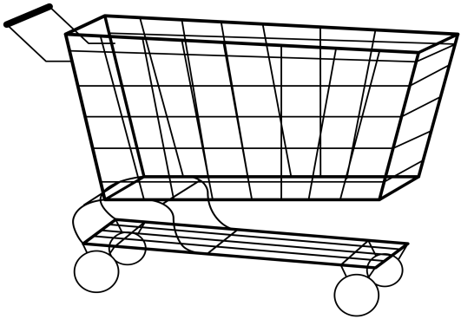
SMART CART
16K41A05E7 - Swaraj
16K41A05F3 - Fahad
16K41A0581 - Rohit
16K41A05C1 - Abhishek
16K41A0504 - Usha
Project Guide: G. Sunil

Slide 2
Abstract
The most valuable thing in today’s world is time, people are referring those things which consumes less time. Billing in Shopping mall takes lot of time. Billing of products from mall is quite difficult because it takes more time as people have to wait for a long time in a queue for billing .Looking at the advancement in technology, we came up with an innovative idea of “Smart Shopping Cart for Automatic Billing in Supermarket”. This project consists of android application with which we can add the items by scanning the bar code. After scanning the item, the item details are send to the micro controller in the trolley. The micro controller then compares the weight of items in the cart with the total calculated weight.

Slide 3
Existing system
In existing system, customer will not know the amount of total purchase, until he went to the counter for paying bill. The customer has to wait in the queue for billing to be done. To avoid these problems we have developed a smart cart which reduces the total time consumed during shopping

Slide 4
Proposed system
Our cart will provide a billing system with option of payment through app .
This cart consists of a QR Code.
This QR code when scanned with app will be connected to that specific cart.
The cart consists of sensors to detect objects.
And finally after completion of the shopping, a code will be generated by the app.

Slide 5
modules
Application and Cart Connectivity Module.
Physical Cart Item Management Module.
Virtual Cart Item Management Module.
Database Management Module.
Billing and Payment Module.

Slide 6
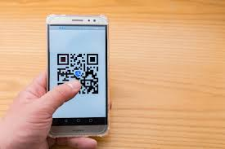
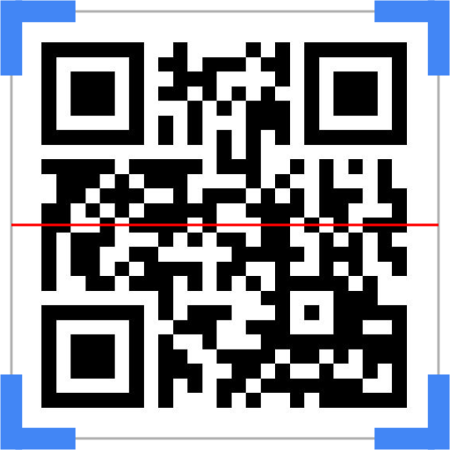

Slide 7

The id generated by the app will be sent to the billing counter which can be paid through app or direct payment .

Slide 8
Software Tools
Android studio.
Arduino IDE/ ESP – IDF.

Slide 9
Hardware tools
ESP32 wifi module-
ESP32 is a system on a chip that integrates the following features:
Wi-Fi (2.4 GHz band)
Bluetooth 4.2
Dual high performance cores
Ultra Low Power co-processor
Several peripherals
Powered by 40 nm technology, ESP32 provides a robust, highly integrated platform, which helps meet the continuous demands for efficient power usage, compact design, security, high performance, and reliability.

Slide 10
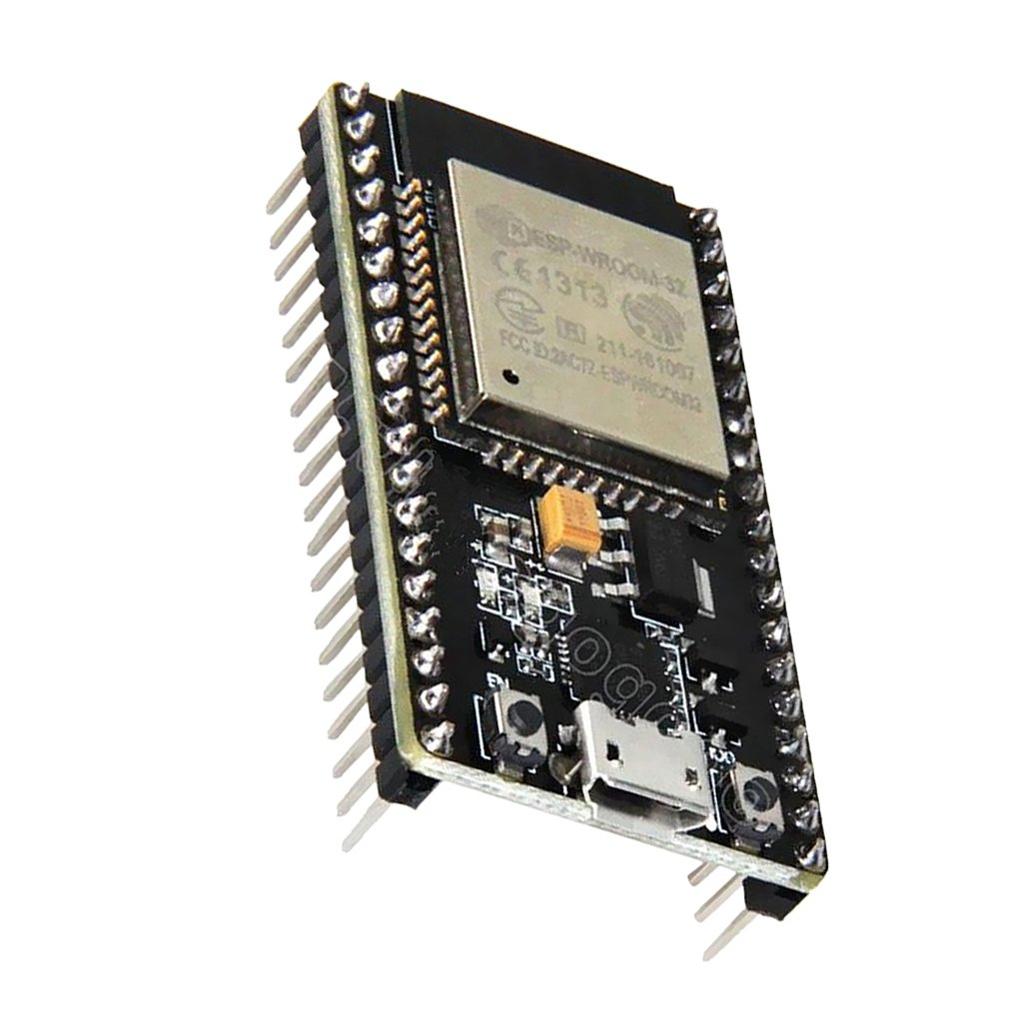

Slide 11
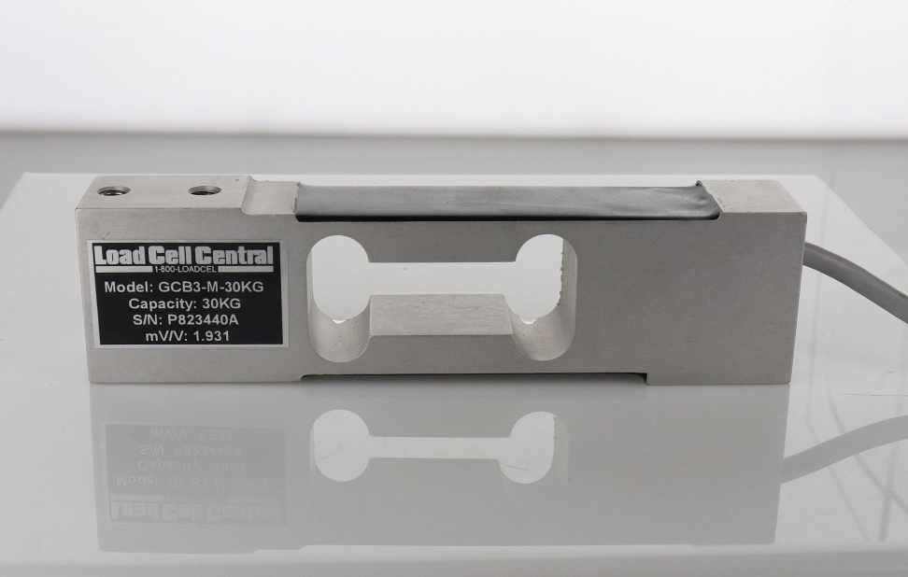
Load Cell-
Single point shear beam load cell: spring element fixed at one end and loaded on the other.

Slide 12
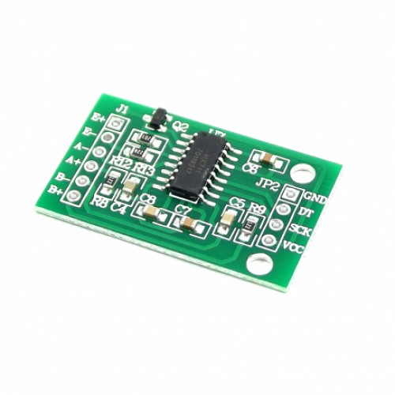
HX-711
HX711 is a precision 24-bit analog to-digital converter (ADC) designed for weigh scales and industrial control applications to interface directly with a bridge sensor.

Slide 13
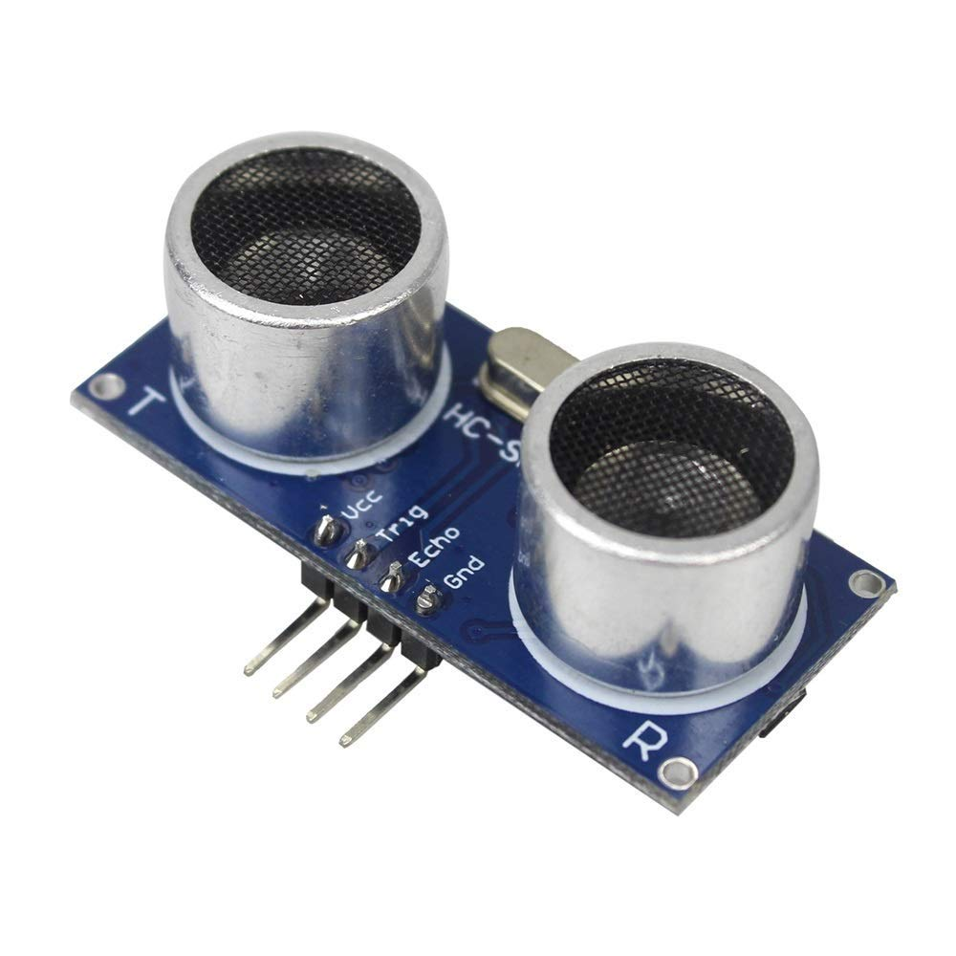
UltraSonic Sensor (HC-SR04) -
Power Supply :+5V DC
Quiescent Current : <2mA
Working Current: 15mA
Effectual Angle: <15°
Ranging Distance : 2cm – 400 cm/1″ – 13ft
Resolution : 0.3 cm
Measuring Angle: 30 degree
Trigger Input Pulse width: 10uS
Dimension: 45mm x 20mm x 15mm

Slide 14
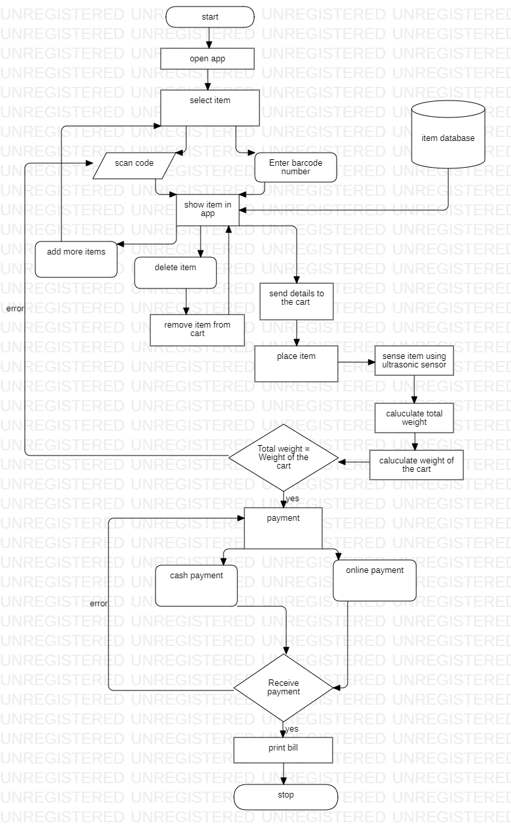
Flow chart

Slide 15
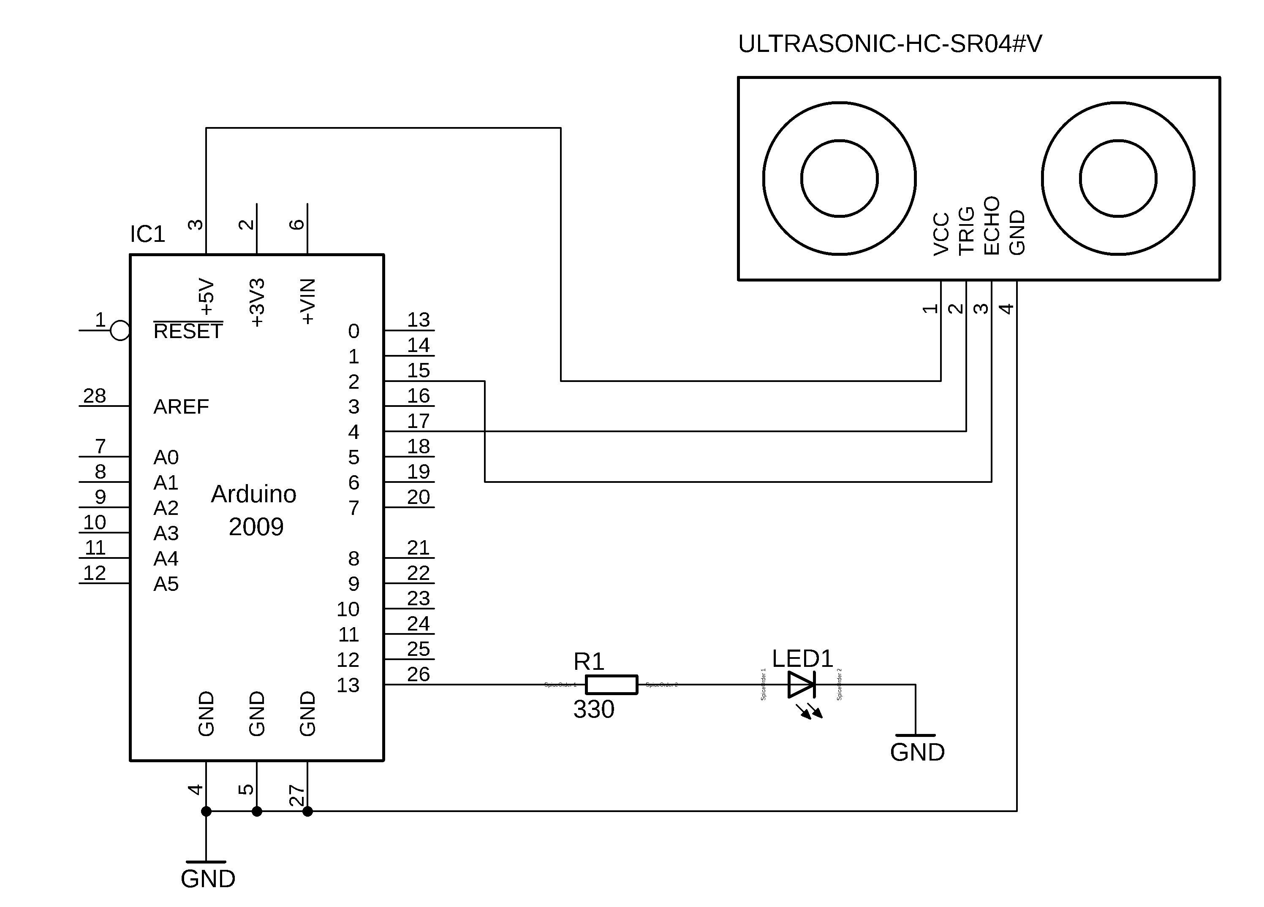
ESP32 and ultrasonic sensor connection

Slide 16
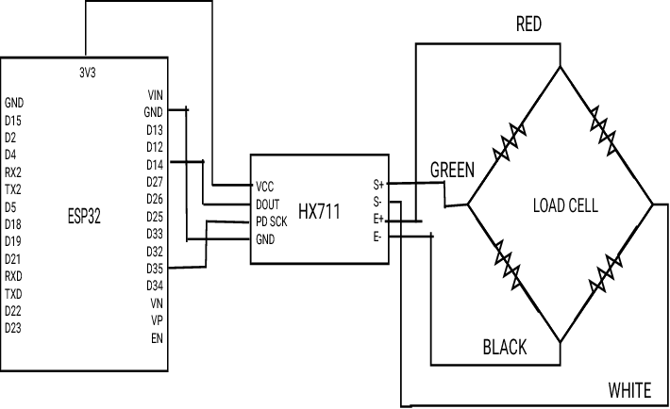
ESP32 and Load cell Connection with HX711

Slide 17
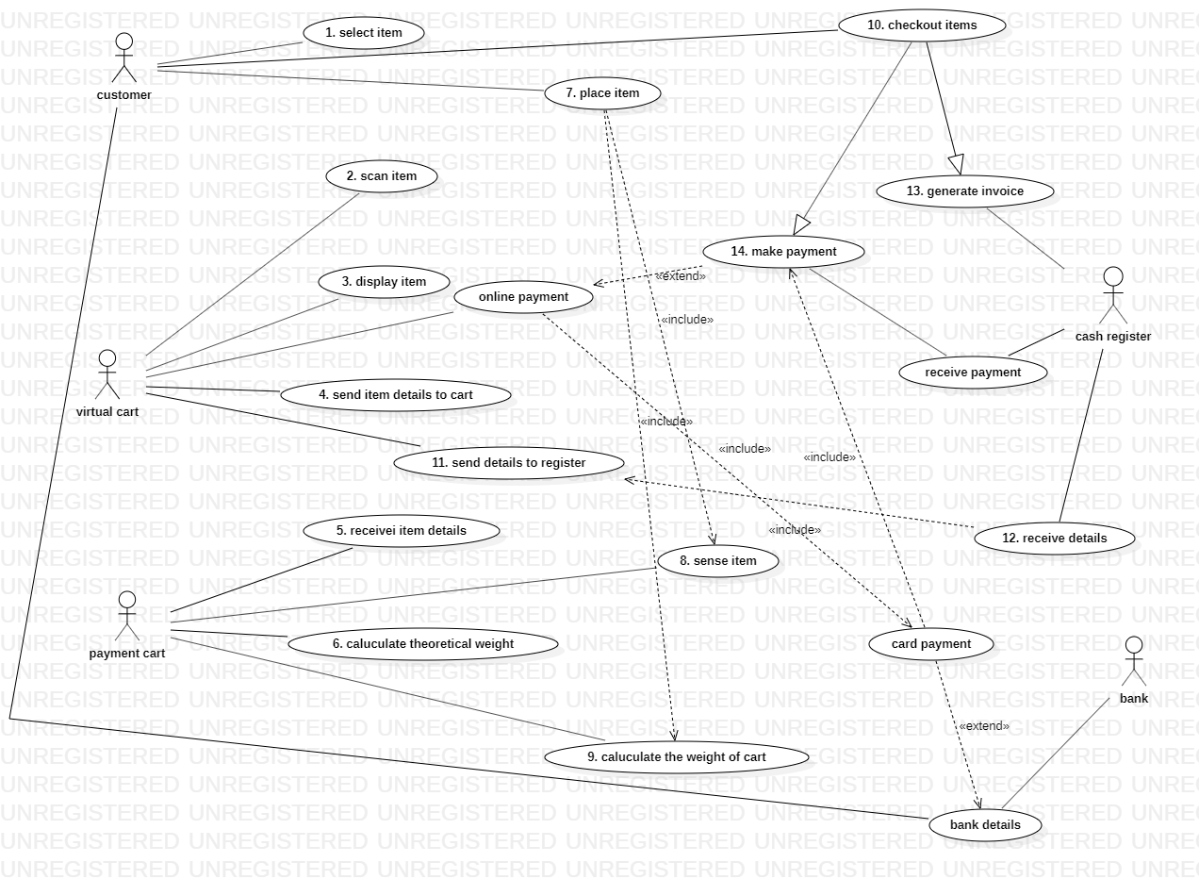
Use case diagram

Slide 18
implementation

Slide 19
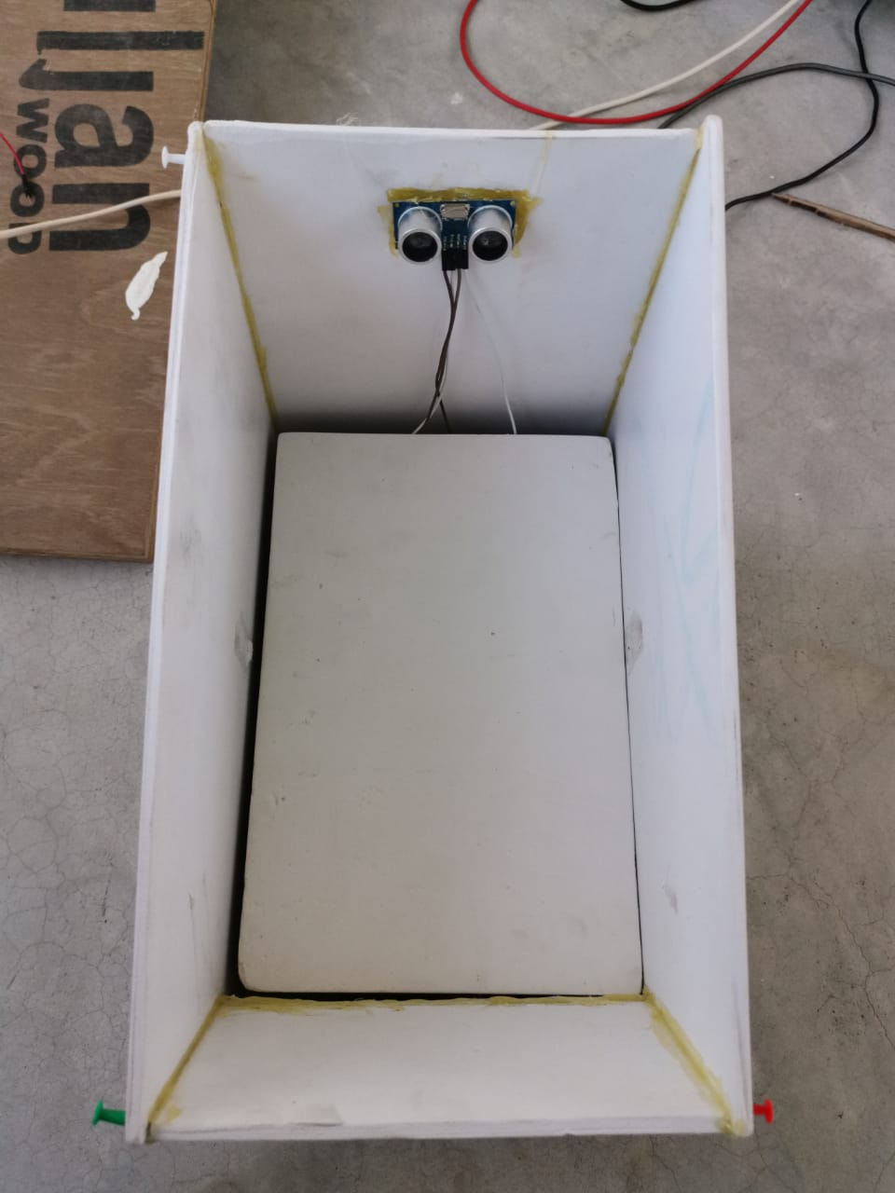
cart

Slide 20
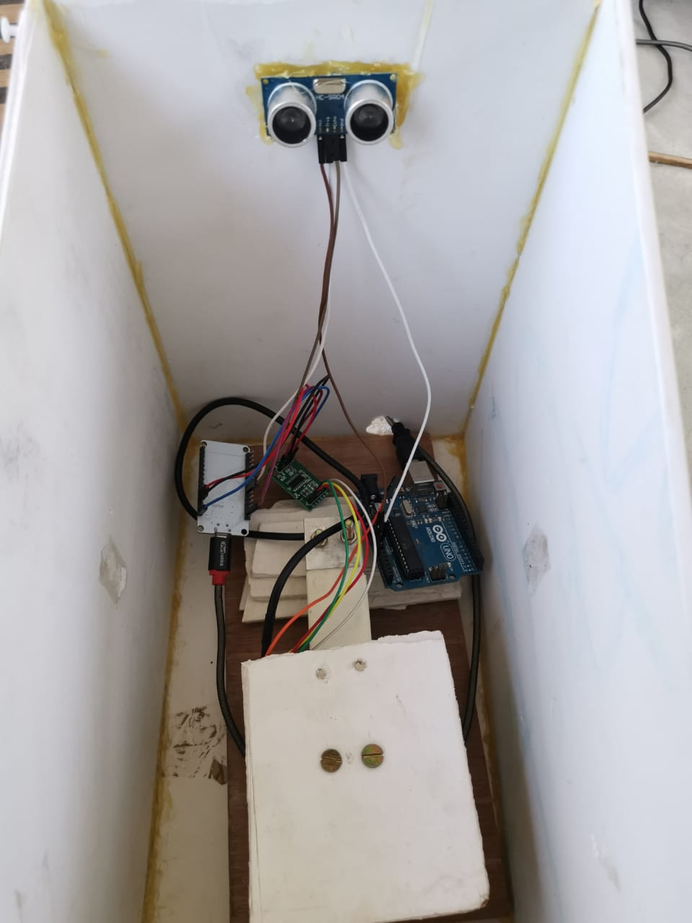
Cart components

Slide 21
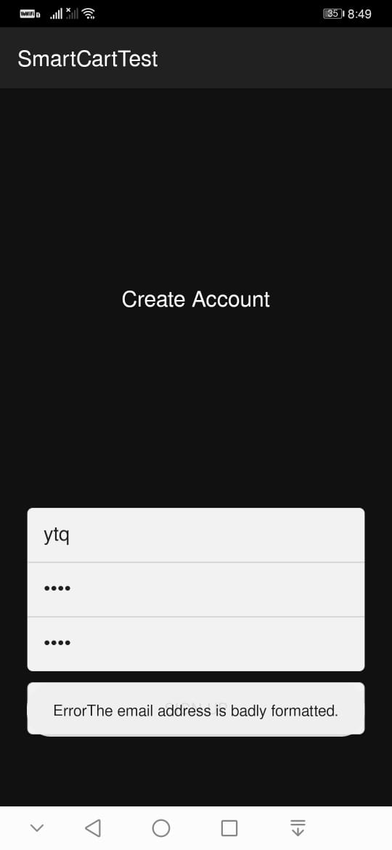
User registration

Slide 22
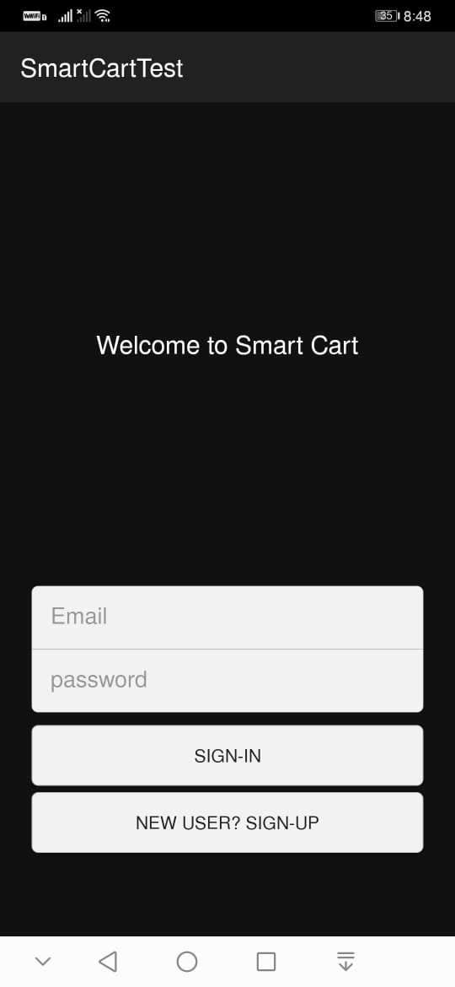
User login

Slide 23
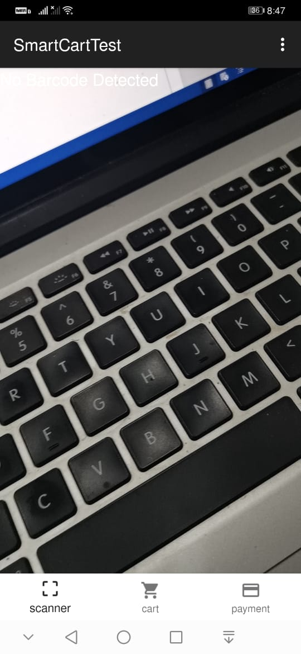
scanner

Slide 24
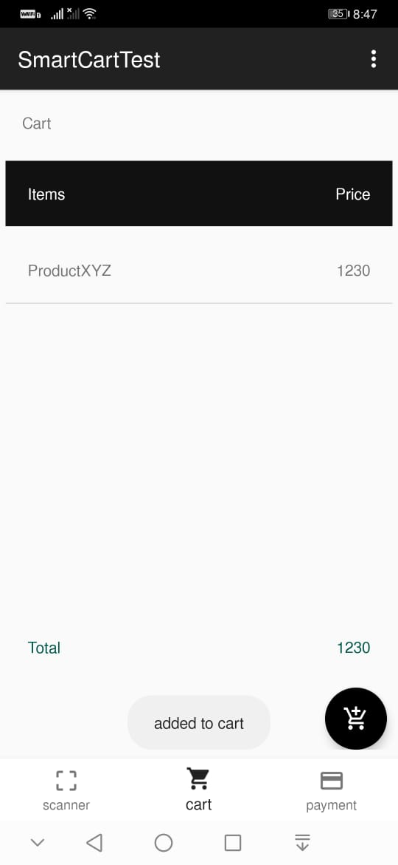
Adding items

Slide 25
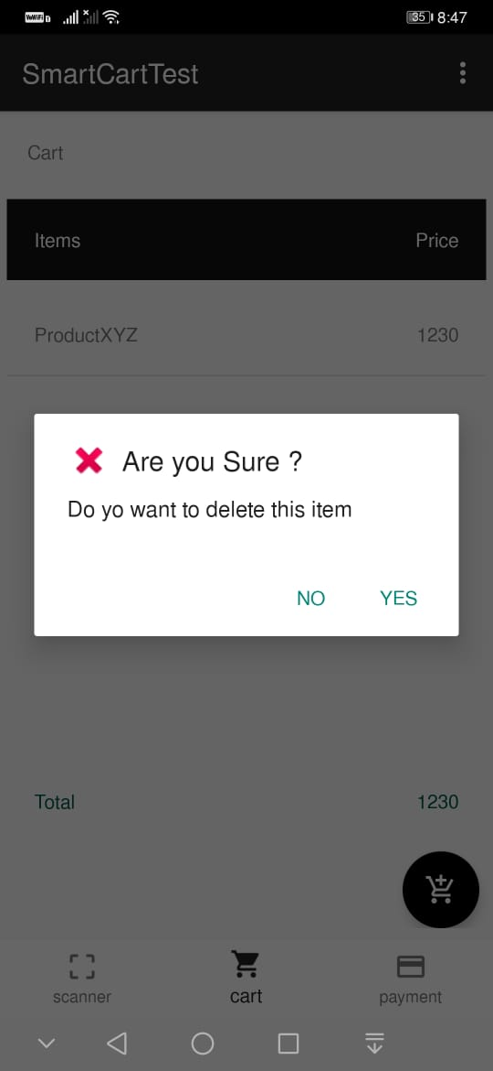
Deleting items

Slide 26
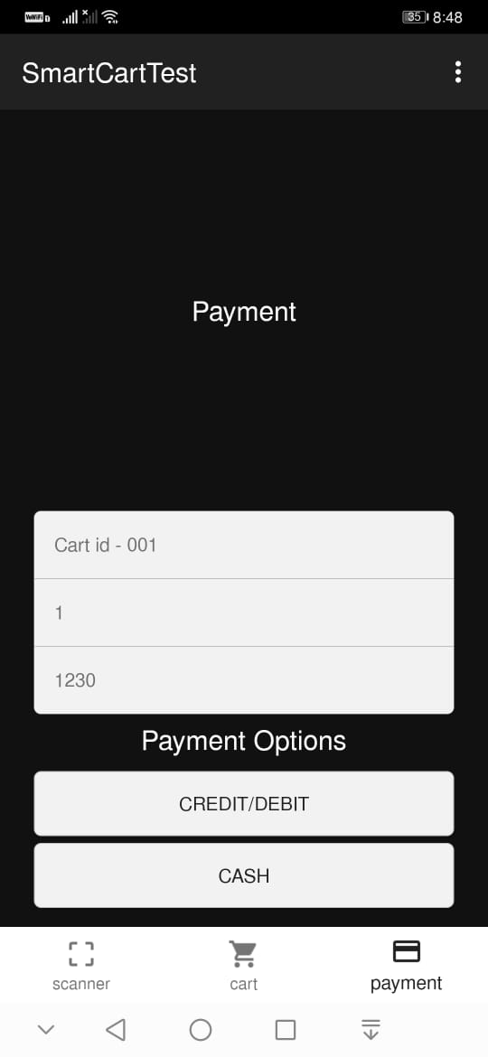
payment

Slide 27
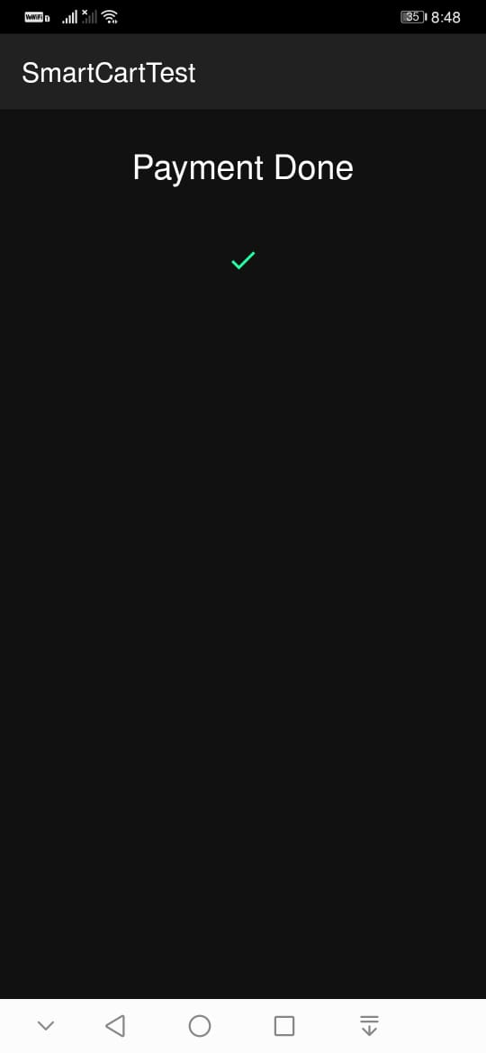
Payment confirmation

Slide 28
Advantages
Comparatively this results in cheaper and fast carting.
Attracts more customers as this is easily accessible.
This system reduces time consumption in billing.

Slide 29

THANK YOU.

